Slide 1


WORKING TOGETHER

Slide 2
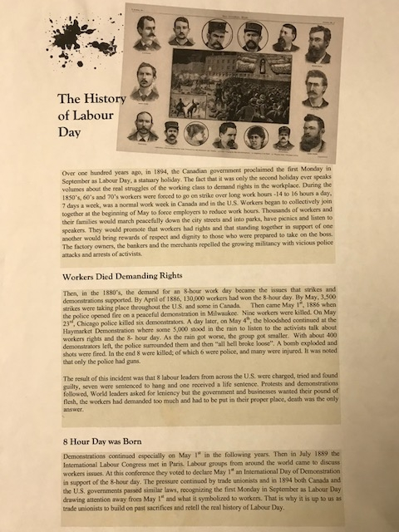
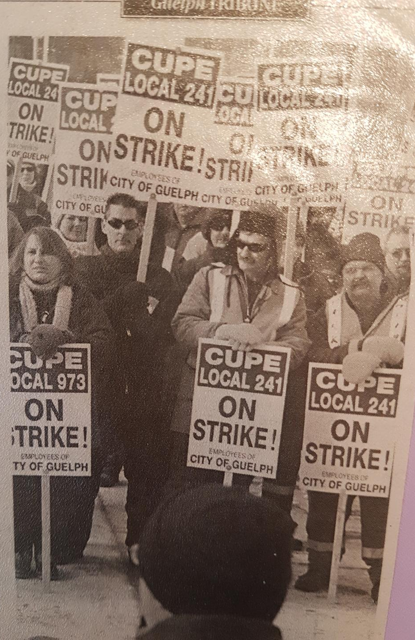
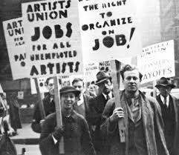
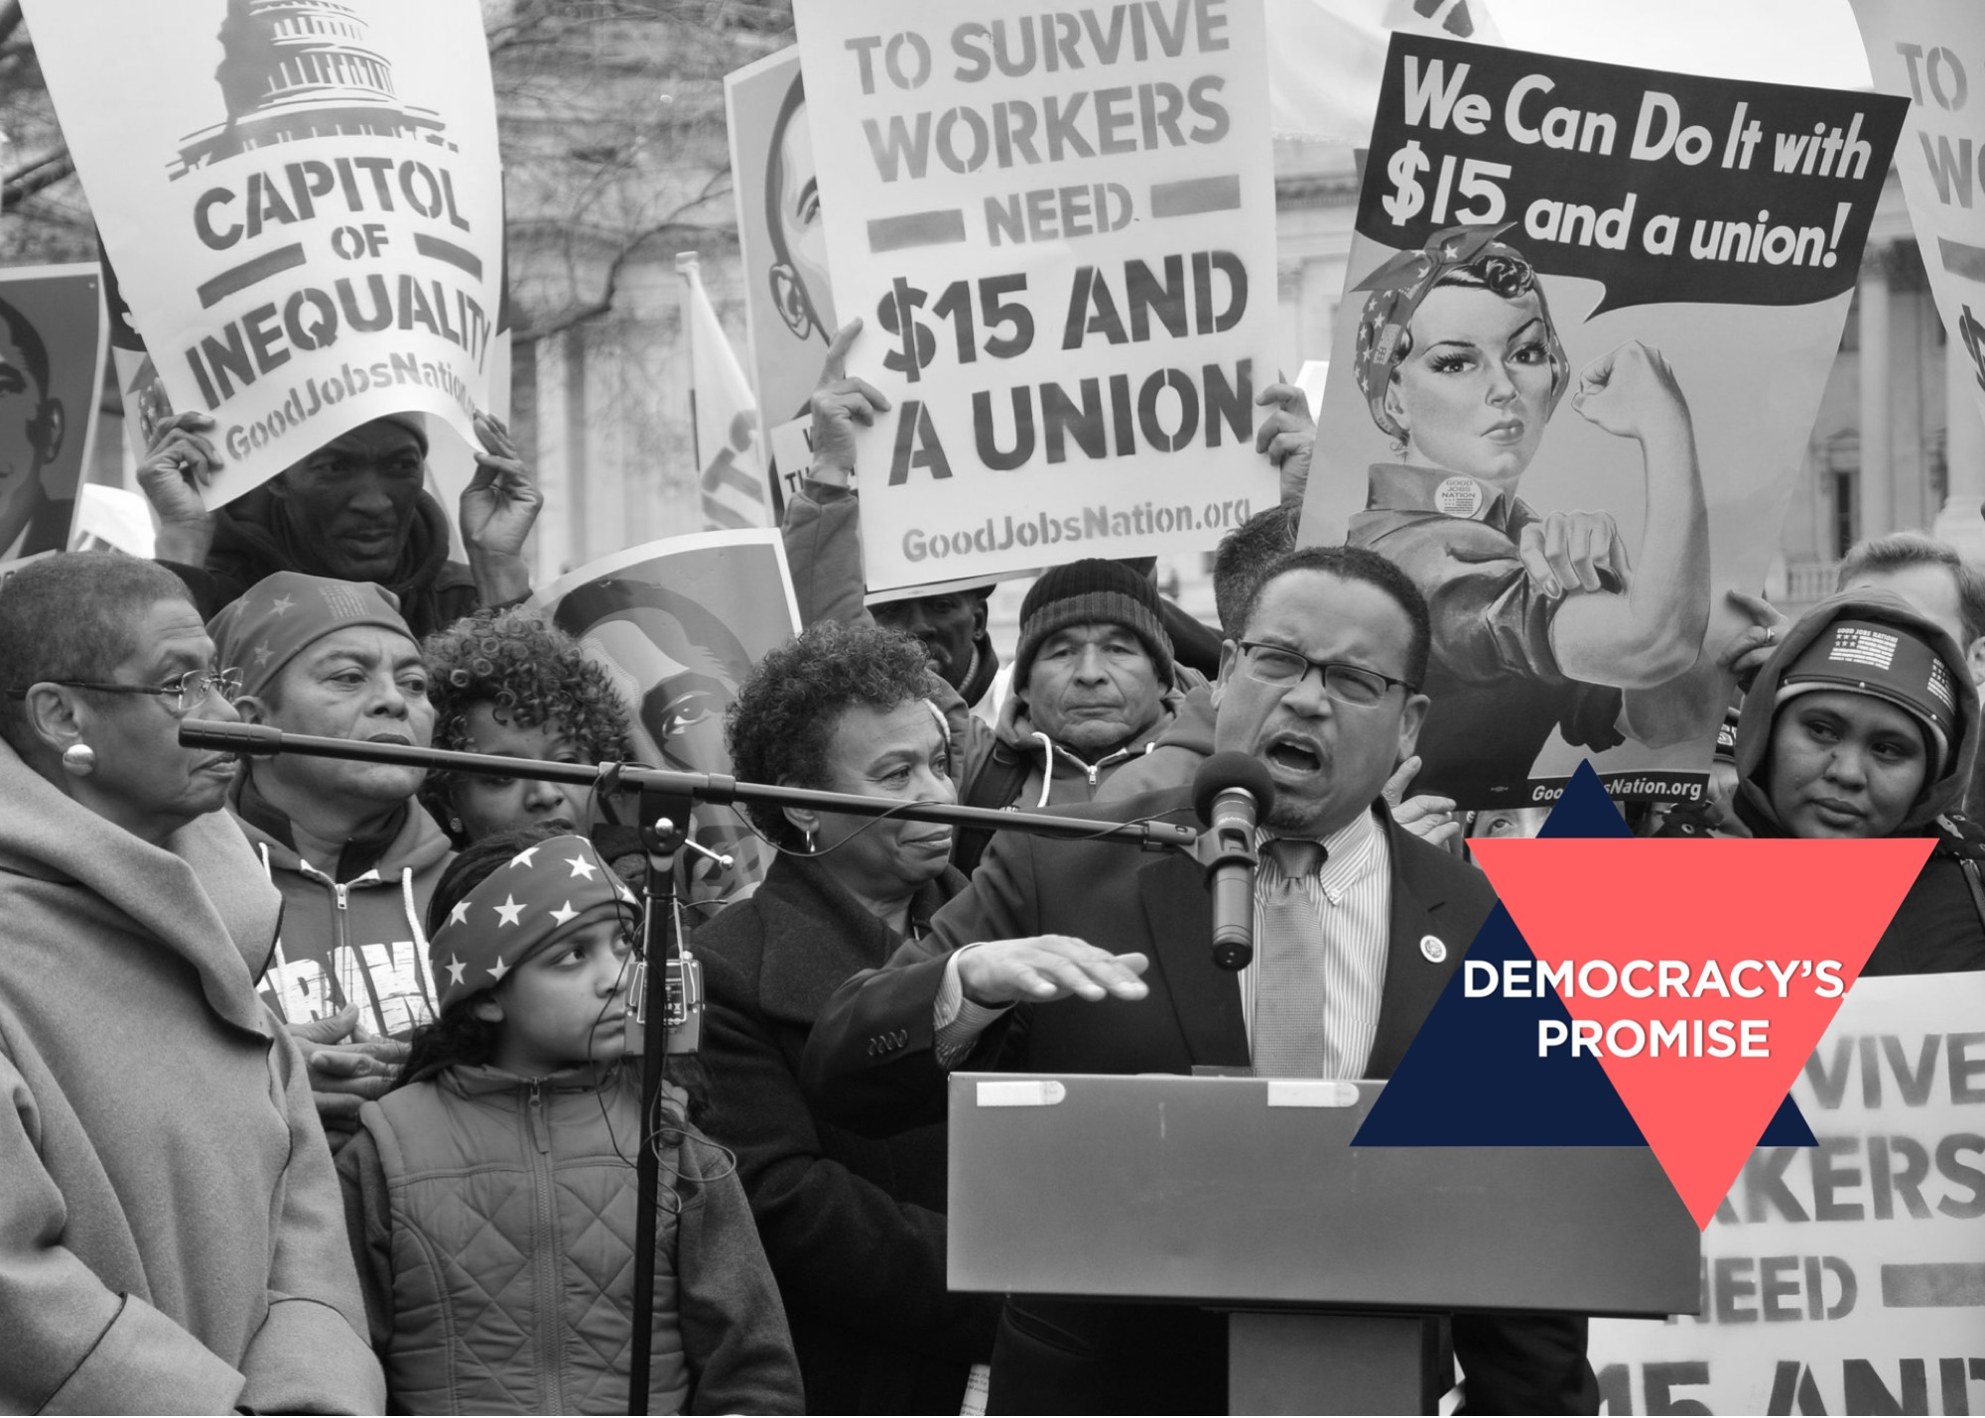

ROLE OF THE UNION

Slide 3
CUPE Local 973
Local 973 is made up of both the City of Guelph Inside Workers and the County of Wellington Social Services Workers.
The Executive Team that has been voted in is made up of the following members:
    Connie McDonald – President
    Jack Pogan – Vice President, City
    James Cassidy – Vice President, County
    Lisa Rajmoolie – Secretary Treasurer
    Megan Holdbrook – Recording Secretary
    Braden Carberry – Chief Steward, City
    Margaret Wrobel – Chief Steward, County

Slide 4
CUPE 973 History
CUPE Local 973 was formed in 1956.
The next screen shows our Collective Agreement from 1964. Some highlights of this agreement include:
  Members paid 50% of the cost of physician services.
  Members had to wait 10 years to get three weeks vacation.
  Managers could request that members work above normal hours without overtime pay.
973 has only went on strike once in it’s history – for 2 weeks in 2006.

Slide 5
CUPE 973 Collective Agreement 1964

Slide 6

Current Collective Agreement
The current Collective Agreement was originally dated from February 1, 2016 to January 31, 2020. Due to Covid-19 impacts during negotiations in 2020, the Bargaining Committees agreed to pause collective bargaining and extend the existing agreement for two (2) more years. The Collective Agreement now expires on January 31, 2022.
A copy of the Collective Agreement can be found on 973's website and on the City's Infonet.
The 973 Seniority List can also be found on the City's Infonet.

Slide 7
973 Website & Membership Meetings
973 has its own website https://973.cupe.ca/ and the following can be found online:
  Contact information of the Executive Team and committee members.
  Collective Agreements.
  973 Bylaw.
  Member meeting minutes which are password protected – contact a member of the Executive Team for the password to access these minutes.
Membership meetings take place on the 4th Monday of the month excluding July, August and December.
  Meetings are currently conducted virtually via WebEx.

Slide 8
Role of the Union
The Role of the union is to:
  Ensure that the Collective Agreement is being followed and adhered to by both management and union members.
  Represent members during the discipline process.
  Support members during investigation meetings either requested by the member or management.
  Negotiate the Collective Agreement at the end of its term.
  Engage members, provide training and assist them with understanding their rights under the Collective Agreement.

Slide 9
Role of the Executive Team and Stewards
The Executive Team is voted on by the membership and Stewards are appointed by the Executive Team. Together they:
  Provide members with support with issues with Management.
  Assist Management in abiding with the Collective Agreement.
  File grievances on behalf of members.
  Facilitate membership meetings where union updates are provided.
  Attend to the day-to-day tasks associated with running a union including reconciling the finances.
  Abide by the Local’s bylaw.
  Provide member’s the opportunity to attend CUPE education courses.

Slide 10
Member Wellness
The Union is here to offer support, recognition and congratulations to our members during different stages in their life. This includes:
  Retirement gifts
  Long service awards
  Death in the family
  Weddings
  Babies
If you, or anyone you know, could use some support or recognition from the union, reach out to our Wellness Coordinator Tracy Benson.

Slide 11
Membership Cards
CUPE 973 members are required to be members in good standing. Being a member in good standing includes:
  New members attending this orientation session.
  Paying the $1 member fee.
  Being issued a CUPE membership card.
Members will receive their member card once the New Member Form has been completed and payment has been made.
Personal information gathered through the New Member Form is for union use only.
You must be a member in good standing in order to vote (i.e. a strike vote).

Slide 12
Reasons to Contact a Steward
The Stewards role is to ensure the Employer is following the Collective Agreement as negotiated. Some reasons to contact a union Steward are:
  You are being requested to work outside of your usual working hours.
  You are being denied vacation.
  Benefits are not being paid out.
  You are being treated unfairly.
  The Collective Agreement isn’t being followed.
  Any return-to-work issues.

Slide 13
Reasons to be Unionized
  Job security
  Pension and benefits
  Higher wages
  Greater equality
  Health & safety
  Predictable hours
  Training & education
  Workplace democracy

Slide 14
Benefits of Unions
Unions allow workers to become united and to mobilize and come together during times of collective agreements and negotiations.
Unions help make a workplace more fair.
In a unionized workplace you have a voice and an advocate.
A union is there to be strong and united and to be there for workers in their struggles.
Unions do international solidarity work and stand up against human rights violations.
Unions are instrumental in fighting for workers’ right to safety in the workplace.

Slide 15
The Grievance Process
  When a member is disciplined or if the Collective Agreement is violated then the Union proceeds with the grievance process.
  If a resolve is not found during this process then the Union has the right to seek resolve either through the mediation or arbitration process.
  The mediation process involves a mediator who listens to both sides of the argument and tries to find a resolution that is amenable to both parties.
  The arbitration process is similar to a court trial and both sides present their case and an Arbitrator or a Board of Arbitrators makes the final ruling.
  At the Mediation/Arbitration stage the City has the option of hearing the grievance either at mediation or arbitration. Mediation is the least expensive way to go.

Slide 16
The Bargaining Process
Step 1. Notice to Bargain
  Notice to Bargain can be served by either party during the last ninety (90) days of the term of a Collective Agreement - this notice needs to be served in writing.
  973’s Bargaining Committee consists of members of the Executive Team.
  If neither party gives notice to bargain, the collective agreement remains in effect for another year.
Step 2. Exchange Proposals
  Legislation requires the parties meet within 15 days from when the notice is given, unless an agreement is made to meet later.
  Proposals represent the ideal language that each party want to achieve in their next collective agreement based on past grievances, language changes, and monetary wants.
  Monetary wants include percentage raises, changes and/or additions to benefits.

Slide 17
The Bargaining Process cont’d
Step 3. Bargaining Starts
  Bargaining generally advances through a series of meetings - the process can be quick or it can take a long period of time to reach a mutual agreement.
  Sometimes during bargaining an impasse is reached between the two sides.
Step 4. The Strike Mandate Vote
  A strike vote is a signal of the membership’s support for the bargaining unit.

Slide 18
The Bargaining Process cont’d
Step 5. Conciliation/Mediation
  Should we be unable to negotiate a new collective agreement at the bargaining table, either party can request the assistance of a conciliator.
  If either side are unable to reach a deal in conciliation, either party can ask the conciliator to file a no board report.
  The issuance of the report triggers a “Cooling Off Period” of 17 working days or 21 calendar days. At the end of this period the parties are in a legal strike or lockout position.
  A few days before the strike/lockout deadline, the parties enter into mediation with a provincially appointed mediator (usually the person who was acting as a conciliator). Mediation can continue up to or past the strike/lockout deadline in an effort to reach a deal.

Slide 19
The Bargaining Process cont’d
Step 6. Strike/Lockout
  If after the process of negotiations, conciliation and mediation, a deal is still not reachable then we are in a legal strike position.
  It’s at this point that either the Employer can lock out the members or the Union can go on strike.
  Notification of a strike or lockout is done through email via the Mobilizing committee.
Step 7. Ratification Vote
  The Ratification vote begins with a special general membership meeting.
  The Bargaining Committee will recommend that the offer either be accepted or rejected by the members of the bargaining unit.
  There will be a time for questions and debate before the offer is put to a vote.
  If the Contract is ratified by the membership, Management will present the proposal to Council for approval.
Step 8. New Agreement
  This is reached once the membership and Council have approved the proposals.

Slide 20
Engaging Members
The goal of the Executive Team is to engage, educate and empower our members. We hope to provide this through the below medians but are always open to ideas from our members.
  Offer education locally
  Virtual monthly membership meetings
  Newsletters
  Social media
  Webinars, telephone town halls
  Member acknowledgment and appreciation
  Social events

Slide 21
All parties continue to work together to make the City of Guelph a top employer for both Unionized and Non-unionized Staff.

